Slide 1




NEXT GEN EMPLOYABILITY PROGRAM
Creating a future-ready workforce
Team Members
College Name
Student Name : Jagadeeshwaran.J
Student ID : au510421205015
Arunai engineering college ,
Tiruvannamalai
Notes:
1

Slide 2

CAPSTONE PROJECT SHOWCASE
Project Title
Building Bus Reservation System using Python and Django
Abstract | Problem Statement | Project Overview | Proposed Solution | Technology Used | Modelling & Results | Conclusion

Slide 3
Abstract
This abstract introduces the development of a robust bus reservation system utilizing the Python programming language and the Django web framework. In response to the growing demand for efficient transportation solutions, particularly in the digital era, this system aims to streamline the booking process, enhance user experience, and provide a scalable solution for bus operators and travelers alike.
The proposed system offers a comprehensive set of features designed to meet the diverse needs of both administrators and users. Through a user-friendly interface, passengers can easily search for available bus routes, select preferred departure and arrival times, choose seats, and make secure online payments. Utilizing Django's built-in authentication and authorization functionalities, the system ensures the security of user data and transactions.
Key components of the system include real-time seat availability updates, route management tools, and integration with popular payment gateways to facilitate seamless transactions. The system provides efficient data management and retrieval, optimizing performance and scalability.
From an administrative perspective, the system offers intuitive dashboards and reporting tools, empowering bus operators to manage routes, monitor bookings, and analyze passenger data effectively. Through centralized management capabilities, administrators can maintain control over various aspects of the system, including pricing, schedules, and inventory management.
Source :ChatGPT,Google,WikiPedia

Slide 4
Problem Statement
Complex Booking Process: Existing bus reservation systems often feature convoluted booking processes, leading to user frustration and decreased conversion rates. Users may encounter difficulties in searching for available routes, selecting preferred departure times, and making secure payments. Simplifying and optimizing the booking process is essential to improve user experience and increase customer satisfaction.
Lack of Real-time Information: Many bus travelers face challenges in accessing up-to-date information on seat availability, route schedules, and fare details. Without real-time updates, passengers may encounter discrepancies between online bookings and actual seat availability, leading to inconvenience and dissatisfaction. Integrating real-time information updates into the reservation system is crucial for providing accurate and reliable booking services.
Administrative Burden: Bus operators often struggle with manual and time-consuming administrative tasks, including route management, inventory tracking, and customer support. Traditional methods of managing bookings and schedules may be prone to errors and inefficiencies, hindering operational performance and scalability. Developing an intuitive administrative interface with automated management capabilities can alleviate the administrative burden and enhance operational efficiency for bus operators.
Source :Google Scholar-Market research and analysis of existing bus reservation systems and their shortcomings.

Slide 5
Project Overview
The project aims to develop a modern, scalable, and user-friendly bus reservation system to address the inefficiencies present in traditional bus booking processes. By leveraging the power of Python programming language and Django web framework, the system will offer a streamlined booking experience for passengers while enhancing operational efficiency for bus operators.
To develop a user-centric bus reservation system that enhances the booking experience for passengers.
To improve operational efficiency for bus operators through automated management tools and real-time updates.
To create a scalable and extensible system capable of accommodating future enhancements and growing user demands.
Source: Google Scholar-Market research and analysis of existing bus reservation systems and their shortcomings

Slide 6
Proposed Solution
User-friendly Booking Interface: The system will feature an intuitive and easy-to-use booking interface, allowing passengers to search for available routes, select preferred departure times, choose seats, and make secure payments seamlessly.
Real-time Updates: Integration of real-time information updates on seat availability, route schedules, and fare details to provide accurate and reliable booking services for passengers. This ensures that the information presented to users is always up-to-date.
Administrative Dashboard: Development of an intuitive administrative dashboard equipped with automated management tools for route planning, inventory tracking, and customer support. This dashboard will empower bus operators to efficiently manage bookings and operations.
Scalability and Extensibility: Designing the system with scalability and extensibility in mind to accommodate future enhancements, third-party integrations, and growing user demands. This ensures that the system can adapt and grow alongside the evolving needs of the bus transportation industry.
Source: Google Scholar-Market research and analysis of existing bus reservation systems and their shortcomings

Slide 7
Project Deliverables:
Fully functional bus reservation system deployed on a web server.
User documentation and guides for utilizing the system.
Administrative documentation for managing and maintaining the system.
Source code repository containing all project files and assets.
By following this project overview, the aim is to create a comprehensive bus reservation system that meets the needs of both passengers and bus operators while leveraging the capabilities of Python and Django to deliver a robust and efficient solution.
Source : Google Scholar-Market research and analysis of existing bus reservation systems and their shortcomings

Slide 8


Technology Used
Front-end
Back-end

Slide 9
Modelling & Results
In the development of the bus reservation system using Python and Django, various modeling techniques and methodologies will be employed to design and implement the system's architecture, data structures, and user interfaces. Additionally, rigorous testing and evaluation processes will be conducted to ensure the system meets the specified requirements and delivers the desired outcomes.
1. System Architecture:
The system architecture will be designed to ensure scalability, reliability, and performance. It will include components such as:
Frontend: Developed using HTML/CSS/JavaScript and Django templates for user interfaces.
Backend: Implemented using Python and Django framework to handle business logic, data processing, and interaction with the database.
Database: Utilizing a relational database management system (e.g., PostgreSQL) to store data related to routes, bookings, users, and other system entities.
APIs: Building RESTful APIs using Django REST Framework to facilitate communication between frontend and backend components.
2. Data Modeling:
Entity-Relationship Diagrams (ERDs) will be used to model the relationships between different entities in the system, such as users, buses, routes, and bookings. This will ensure that the database schema is well-structured and optimized for efficient data retrieval and manipulation.

Slide 10
3. User Interfaces:
User interface mockups and wireframes will be created to design the layout, navigation flow, and visual elements of the system. These mockups will then be translated into functional frontend components using HTML, CSS, JavaScript, and Django templates.
4. Implementation:
The system will be implemented according to the proposed architecture and design specifications. Python and Django will be used to develop the backend logic, while frontend components will be built using HTML/CSS/JavaScript and Django templates. Database interactions will be managed using Django's ORM (Object-Relational Mapping) to ensure data integrity and consistency.
5. Testing and Evaluation:
A comprehensive testing strategy will be employed to validate the functionality, usability, and performance of the system. This will include unit testing, integration testing, and user acceptance testing to identify and address any issues or bugs. User feedback and usability testing will also be conducted to gather insights and make iterative improvements to the system.
6. Results:
Upon completion of the development and testing phases, the bus reservation system will be deployed to a web server for production use. Key performance metrics such as system uptime, response time, and user satisfaction will be monitored to evaluate the system's effectiveness in meeting its goals.
Overall, the modeling and results of the bus reservation system project will demonstrate the successful implementation of a modern and efficient booking platform, providing users with a seamless and enjoyable experience while optimizing operational processes for bus operators.

Slide 11
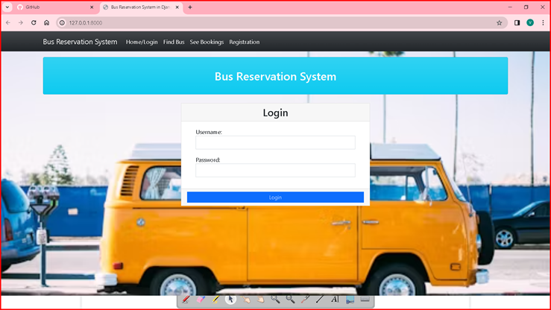
Homepage

Slide 12
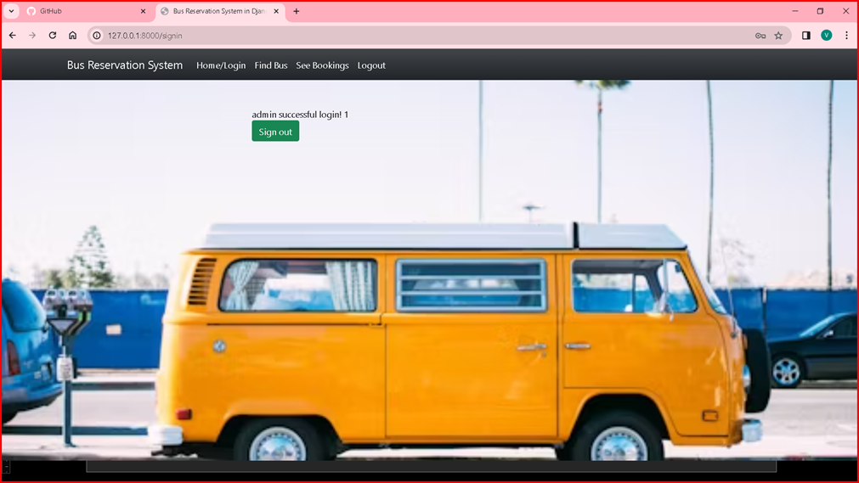
Admin page

Slide 13
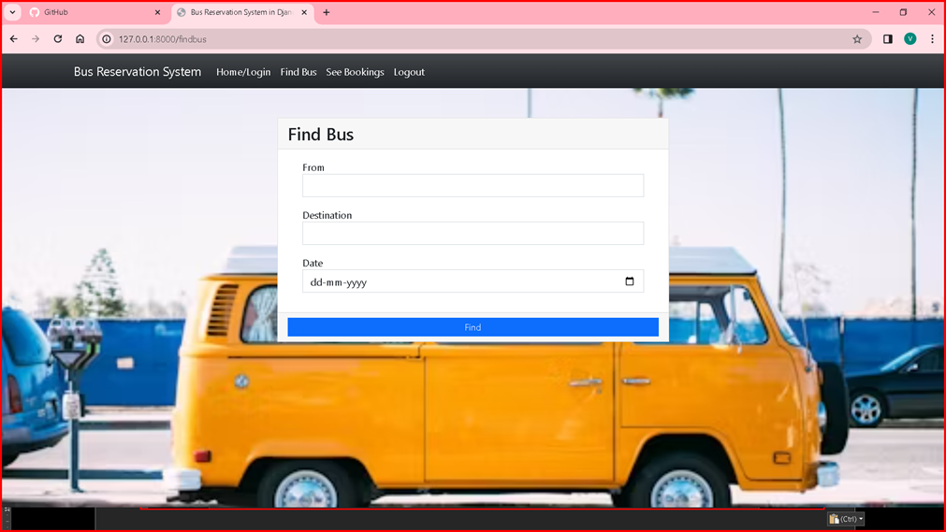
Finding the bus-Page

Slide 14
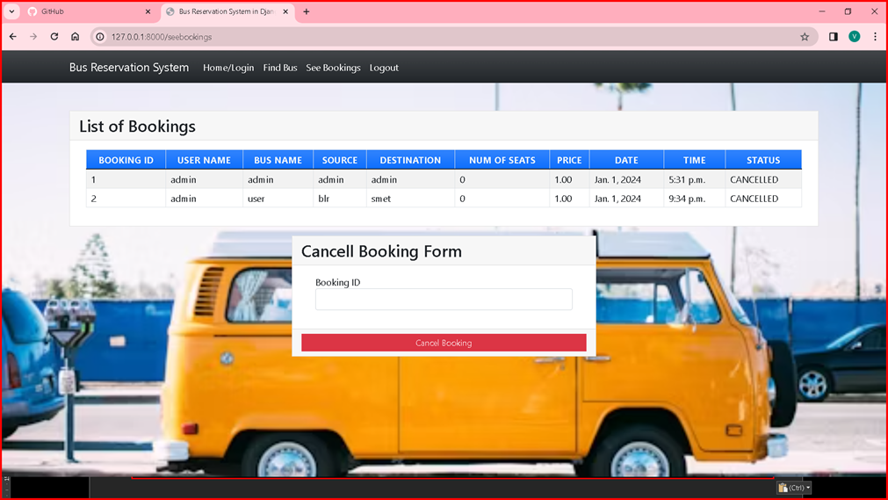
Booking-Page

Slide 15
Future Enhancements:
While the initial development of the bus reservation system will focus on meeting the core requirements and delivering a functional solution, there are several potential future enhancements that can further improve the system's functionality, user experience, and efficiency. These enhancements can be implemented iteratively based on user feedback, emerging technologies, and evolving business needs. Some possible future enhancements include:
Mobile Application Development
Integration with Transit APIs
Personalized Recommendations
Accessibility Features
Virtual Reality (VR) Seat Selection
Enhanced Security Measures

Slide 16
Conclusion
Overall, the bus reservation system represents a significant step forward in modernizing bus travel and meeting the evolving needs of passengers and bus operators. By embracing innovation, user feedback, and continuous improvement, the system has the potential to become a trusted and indispensable platform for booking bus tickets and facilitating seamless journeys for travelers around the world.

Slide 17
Thank You!
Notes:
Thank You !!

